Slide 1
C29PE Economics for Professionals
Week 10 – The Case for Demand Management
Sloman et al., 2023, Chapters 29-30

Slide 2
Session Aims
To explore macroeconomic theory
  Fixed price model – circular flow of income and expenditure
  Variable price model – aggregate supply and aggregate demand re-visited
  Phillips Curve
To understand the role for government policy for demand management
  Reducing unemployment, controlling inflation
  Types of policies

Slide 3
References
Sloman et al (2023)
  Chapter 29.1 – 29.3
  Box 29.1
  Chapter 30.1 – 30.3
  Boxes 30.1 & 30.3
Important!
  The PowerPoint slide deck for Week 10 lecture provides a guideline of the topics you need to know. However, the materials in the slide deck are insufficient if you wish to excel in the course
  To do well, please do not forget to read the relevant sections of the core textbook
  Please also ensure that you follow economics news regularly as these sources could be used as examples to supplement your answers during assessments

Slide 4
Income and expenditure
Y: national income (GDP)
  Household spending C – consumption
    Y – C = W: Withdrawals = savings, taxation, imports – W = S + T + M
  Household income Y - C = J – Injections
    Injections = investment, government spending, exports – J = I + G + X
Equilibrium when national income equals aggregate expenditure
  Two conditions: since Y = C + W = C + J, W = J
    And since AE = C + I + G + (X – M)
    By definition of GDP -> Y = C + I + G + (X – M)

Slide 5
A diagram of the simple Keynesian model
Two axes –
  National income (Y – GDP) measured on the horizontal, aggregate expenditure (AE) on the vertical
  Assume that AE increases when Y increases, but more slowly
Equilibrium: where AE line meets the 45º line diagram, AE = Y

Slide 6
Equilibrium national income
C_{d}, W, J
(£bn)
Y = AE
AE = C + I + G + X - M
45°
O
National income (Y) (£bn)

Slide 7
When injections equal withdrawals
Think of circular flow
  Households receive income Y, spend C, withdraw W
    So for an equilibrium, Y = C + W
  Spending on output produced in the economy AE = C + J
    For an equilibrium, where Y = AE, C + W = C + J (and J = W)
Suppose that AE > Y – there is an increase in exports
  Organisations sell more output – make more profit
    Invest in labour - Have higher wage costs;
    Household income increases, so consumption increases;
    Government revenues increase, so it increases spending;
  Many effects, which feed into each other
    What restores equilibrium? Injections again equal to withdrawals

Slide 8
A unique, stable equilibrium where J = W and Y = AE
C_{d}, W, J
(£bn)
Equilibrium national income is where Y = AE (and W = J).
c
d
Y = AE
e
AE = C + J - M
a
b
45°
O
Y₁
Y_{e}
Y₂
National income (Y) (£bn)

Slide 9
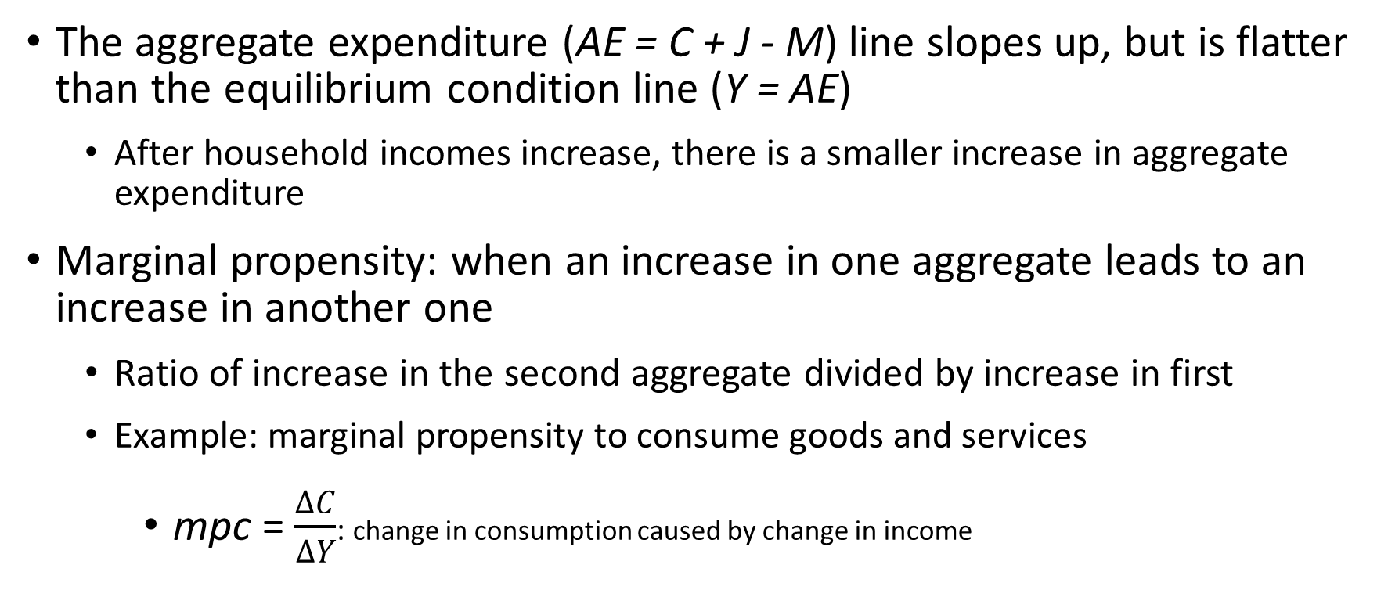
Marginal propensities
The aggregate expenditure (AE = C + J - M) line slopes up, but is flatter than the equilibrium condition line (Y = AE)
  After household incomes increase, there is a smaller increase in aggregate expenditure
Marginal propensity: when an increase in one aggregate leads to an increase in another one
  Ratio of increase in the second aggregate divided by increase in first
  Example: marginal propensity to consume goods and services
    mpc = $\frac{∆C}{∆Y}$: change in consumption caused by change in income

Slide 10
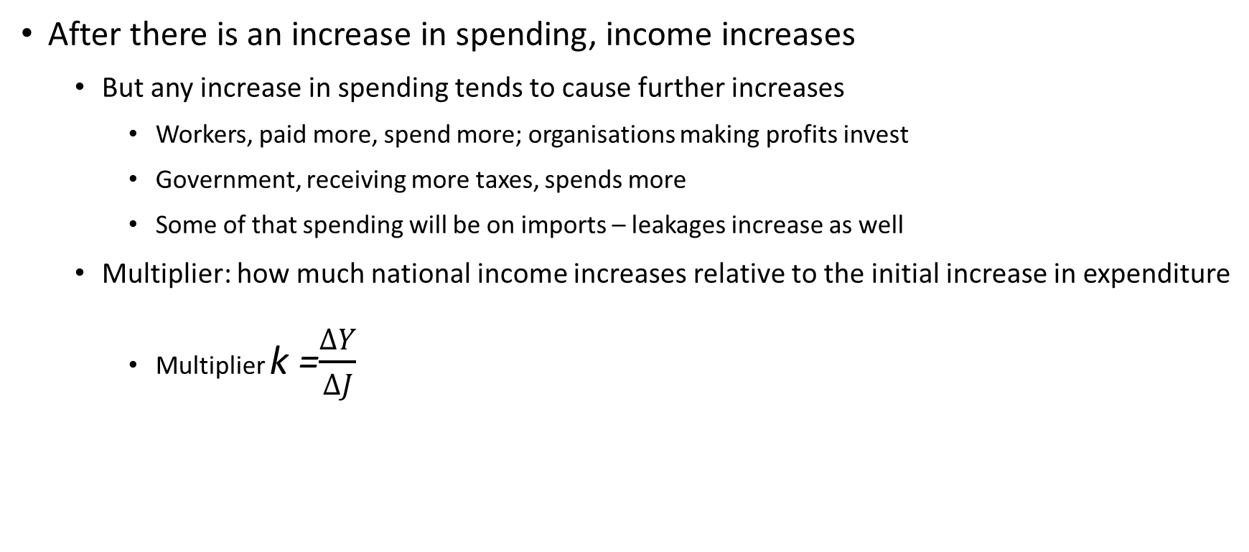
The multiplier
After there is an increase in spending, income increases
  But any increase in spending tends to cause further increases
    Workers, paid more, spend more; organisations making profits invest
    Government, receiving more taxes, spends more
    Some of that spending will be on imports – leakages increase as well
  Multiplier: how much national income increases relative to the initial increase in expenditure
    Multiplier k =$\frac{∆Y}{∆J}$

Slide 11
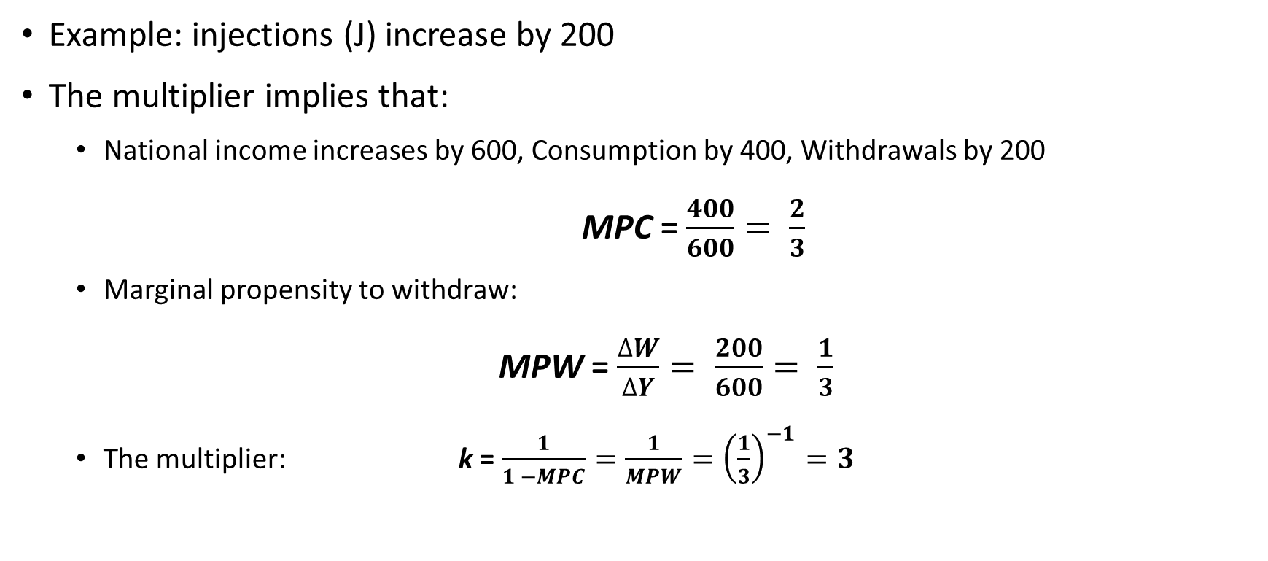
The multiplier and marginal propensities
Example: injections (J) increase by 200
The multiplier implies that:
  National income increases by 600, Consumption by 400, Withdrawals by 200
    MPC = $\frac{400}{600}= \frac{2}{3}$
  Marginal propensity to withdraw:
  MPW = $\frac{∆W}{∆Y}= \frac{200}{600}= \frac{1}{3}$
  The multiplier: k = $\frac{1}{1 −MPC}=\frac{1}{MPW}={\left(\frac{1}{3}\right)}^{−1}=3$

Slide 12
The policy problem – full employment
  Define ‘full-employment’ (Y_{F}) as level of national income without demand-deficient unemployment
  What to do if equilibrium national income Y* < Y_{F}
    Then recessionary (deflationary) gap exists
    Can address this by increasing expenditure – by managing injections
      Government could increase own expenditure on goods and services (G)
      Or reduce interest rates to increase investment (I)
      Will examine such fiscal and monetary policy interventions later.

Slide 13
The recessionary gap
Aggregate
expenditure (E)
Y
Note that (a-b) is smaller than (Y_{F}-Y_{e}): multiplier effect
E
a
b
Recessionary gap
Recessionary gap
The amount by which national income exceeds aggregate expenditure at the full-employment level of national income
O
Y_{e}
Y_{F}
National income (Y)
Notes:
13

Slide 14
The policy problem – full employment
  What to do if equilibrium national income Y* >Y_{F}
    Then inflationary gap exists
    Can address this by reducing expenditure – by managing injections
      Government could reduce own expenditure on goods and services (G)
      Or increase interest rates to reduce investment (I)
      Will examine such fiscal and monetary policy interventions later.

Slide 15
The inflationary gap
Aggregate
expenditure (E)
Y
E
Note that (c-d) is smaller than (Y_{F}-Y_{e}): multiplier effect
Inflationary gap
The amount by which aggregate expenditure exceeds national income at the full-employment level of national income
c
d
Inflationary gap
O
Y_{e}
Y_{F}
Notes:
15

Slide 16
Short Run Aggregate Supply: Extreme case
Short run Aggregate Supply (SRAS) horizontal
Prices are fixed (sticky)
Any increase in D is reflected in an increase in income
No effects on prices until full-employment is reached

Slide 17
The fixed price level in AS-AD analysis
AS
Aggregate supply totally dependent on aggregate demand up to full-employment income
Price level
a
b
P
AD₂
AD₁
O
Y₁
Y₂
Y_{F}
Real national income (GDP)
Notes:
17

Slide 18
Short Run Aggregate Supply
Flexible price approach - The SRAS to be upward sloping, and steeper as it approaches Y_{F}
  Reflects some stickiness in wages and prices
  An increase in AD will have impact on prices and income

Slide 19
Upward sloping short-run aggregate supply cureve
AS
Aggregate supply becoming less and less responsive to aggregate demand as spare capacity is used up
Price level
b
P₂
a
P₁
AD₂
AD₁
O
Y₁
Y₂
Real national income (GDP)
(b) Mainstream position
Notes:
19

Slide 20
Long Run Aggregate Supply
Means that prices are fully flexible
  Any change in aggregate demand will feed through to the price level
  Output constant, so LRAS vertical
This is short run in New Classical approach
  Only if there is full information, so that changes in demand anticipated
  Two assumptions:
  market clearing (all markets adjust to the new equilibrium),
  ‘rational’ expectations (people use all available information to make decisions)
An increase in AD leads only to increase in prices, no effect on income

Slide 21
Long-run aggregate supply curves
AS
Aggregate supply is independent of aggregate demand because changes in AD are anticipated
AS (P^{e} = P₂)
c
Price level
P₂
b
AS (P^{e} = P₁)
P₁
a
AD₂
AD₁
O
Y_{p}
Real national income (GDP)
(c) New classical position
Notes:
21

Slide 22
Vertical Long-run Aggregate Supply
Means capacity determined by practical constraints
  If demand increases, organisations initially try to produce more
    Output price level increase, along with output
    (Sticky) input prices – including wages – take time to adjust
      Costs increase – eroding profits – so higher demand means higher prices in long-run
  Differences between economists about speed of adjustment
    This is the Keynesian/New Classical dispute
Quiz: What factors will shift LRAS?

Slide 23
Long-run aggregate supply curve
LRAS
Real aggregate supply totally unresponsive to changes in aggregate demand in the long run
Price level
P₂
A rise in aggregate demand will merely lead to higher prices, not higher output
P₁
AD₂
AD₁
O
Y_{P}
Real national income (GDP)

Slide 24
Despite arguments about different types of Aggregate Supply curves, there are areas of agreement:
  Changes in AD can have a significant effect on output and employment in the short run
    if economy is in a deep recession, it may be necessary for the government to expand AD
    if the economy is near full employment, expansion in AD will have little effect on output and more effect on prices
  In the long run, changes in AD will have much less effect on output and employment and much more effect on prices
Quiz: How do the different approaches to aggregate supply affect the multiplier?

Slide 25
Phillips’ curve
1958 – A. W. Phillips estimated relationship between wage inflation, unemployment
  Purely statistical argument – no clear theoretical underpinnings
    Can explain short-run relationship between prices, unemployment
    When AD increases, inflation increases, and unemployment decreases (upward movement along the curve)
    The position depends on non-demand factor causing inflation and unemployment (frictional and structural unemployment, cost-push inflation etc)
    But if structure, capacity of economy changes, Phillips relation will change
Notes:
4

Slide 26
Expectations of inflation and the Phillips curve
π (%)
b
The vertical difference between the two curves is the difference between the expected rate of inflation that augments each curve, (π_{b}−π_{a}) = (π₂−π₁).
π_{b}
π_{a}
a
EAPC₂ (π^{e} = π₂ )
O
U₁
U (%)
EAPC₁ (π^{e} = π₁)

Slide 27
Adjustment to planned increase in aggregate demand
π (%)
LRPC
  Increase in AD
    movement along EAPC
    inflation rises (π↑)
    next period, expected inflation rises and so EAPC shifts up
  Long-run equilibrium at U_{n}
  Vertical LRPC
  Decrease in AD
    inflation falls (π↓)
    next period, expected inflation falls and so EAPC shifts down
b
c
π₁
EAPC₁ (π^{e} = π₁ )
a
d
O
U₁
U_{n}
U₂
U (%)
EAPC₀ (π^{e} = 0)

Slide 28
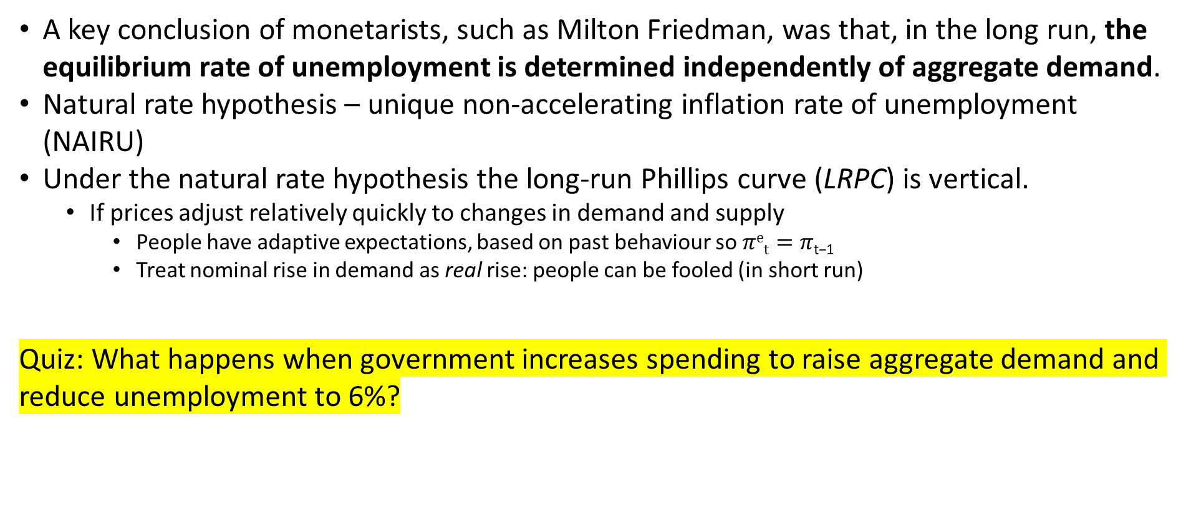
Output, Unemployment and Inflation
A key conclusion of monetarists, such as Milton Friedman, was that, in the long run, the equilibrium rate of unemployment is determined independently of aggregate demand.
Natural rate hypothesis – unique non-accelerating inflation rate of unemployment (NAIRU)
Under the natural rate hypothesis the long-run Phillips curve (LRPC) is vertical.
  If prices adjust relatively quickly to changes in demand and supply
    People have adaptive expectations, based on past behaviour so $πet=π\text{t}\text{−1}$
    Treat nominal rise in demand as real rise: people can be fooled (in short run)
Quiz: What happens when government increases spending to raise aggregate demand and reduce unemployment to 6%?

Slide 29
Fiscal Policy and the Public Finances
Fiscal policy
  seeks to control aggregate demand by altering the balance between government spending and taxation
Roles for fiscal policy
  correcting a fundamental disequilibrium (prevent an economy experiencing a severe or prolonged recession)
  stabilisation policies (smooth out the fluctuations in the economy associated with the business cycle)
  to influence aggregate supply (increase the rate of growth of the economy’s potential output and reduce the natural rate of unemployment)

Slide 30
Fiscal Policy
Two levers: spending (injection), taxation (withdrawal)
  Fixed price model – can rely on multiplier effects
  AS-AD model – effectiveness depends on shape of AS curve
Interested in management of government finances
  Typically think in terms of position of central government
    Which spends more than its tax receipts, so has to finance a deficit
    Interested both in (stock of) national debt; revenue deficit (flow into debt)
Finance by tradable instruments – (short term) bills, (long term) bonds
Notes:
30
30
2

Slide 31
Elements of public finance
Thinking about receipts, spending across public sector
  Most government spending on current needs – health, education
    But also substantial capital expenditures – road building, weapons systems
  Only final expenditure part of AD
    Should exclude transfers (subsidies and benefits)
  Deficit: accounting basis - public-sector net borrowing (PSNB) (through bonds sale)
    Money borrowed every year: public-sector net cash requirement (PSNCR)
  Can calculate total public-sector net debt (gross debt minus liquid assets)
Notes:
31
31
2

Slide 32
Are these deficits sustainable?
A full answer depends on factors: interest rates on outstanding debt, growth rate of the economy, primary surplus (deficit)
A primary surplus (deficit) occurs when public-sector receipts are greater (less) than public-sector expenditures excluding interest payments.
For the public sector to be able to run a primary deficit without the debt-to-GDP ratio rising, the rate of economic growth must be greater than the rate of interest.
The need to raise revenue from taxation are greater the higher the debt-to-GDP ratio and the lower the rate of economic growth.
Notes:
32
32
2

Slide 33
Business cycle and public finances
Public finances tend to be anti-cyclical
Tax revenue high, borrowing low in boom – reverse in recession
Structural deficit captures borrowing after allowing for cyclical effects
The government’s fiscal stance refers to whether it is pursuing an expansionary or contractionary fiscal policy.
  Expansionary stance: tax, spending decisions contribute to injections exceeding withdrawals – typically requires deficit finance
  Contractionary stance opposite – government policy reduces output
Notes:
33
33
2

Slide 34
Using tax and spending actively
Government stance chosen to affect aggregate demand
As well as automatic stabilisers, can use discretionary fiscal policy
  Adjust G (and J), T (and W) to close inflationary, contractionary gaps
  To be effective, need to
  forecast future demand accurately – thinking about time lags in spending
  include effects of policy measures on injections, withdrawals,
  model multiplier effects on national income, and
  take into account effects on other macroeconomic objectives, such as inflation, long-run run growth

Slide 35
Implementing discretionary policy
Increasing government expenditure can cause crowding out
  Borrowing raises interest rates, reduces expenditure
    Puts upward pressure on exchange rate, affect net exports,
  But if spending restores business confidence, investment will rise
    May also lead to better conditions in credit markets, sustaining investment
  Cutting taxes has smaller multiplier effects than increasing spending
    Households spend smaller proportion of temporary than permanent tax cut
Timing problems – want to anticipate future needs
  Recognition, planning, implementation, response lags all important
    Policy stance chosen for today’s circumstances may be destabilising when takes effect in two years

Slide 36
Fiscal policy: stabilising or destabilising?
Path (a): no policy
Path (b): effective anticipation
Path (c): mistimed anticipation
3
4
Real national income
3
2
4
2
1
Since 1945, use of demand
management has tended to reduce
fluctuations – as on path (b)
1
O
Time

Slide 37
Monetary Policy
Using central bank to manage conditions in credit market
  Interest rates are important tools – bank rate: lending by CB to commercial banks to fund operations
  Managed equilibrium – CB has monopsony power?
Another form of aggregate demand management
  Higher interest rates reduce investment, demand, inflation (prices?)
    Policy can operate automatically, or with discretion
  CB mandate for price stability then determines policy stance
  Often seen as long-term objective – not way of ‘fine-tuning’ demand
Notes:
37
4

Slide 38
Managing monetary policy
In longer-term, policy involves regulation to control liquidity
  Impose minimum reserve ratios – other bank keep mandatory deposits at CB
    Now seen as part of prudential regulation of financial system stability
Also limits on government deficits
  Avoid monetary financing (government borrowing tends to lead to an increase in money supply , public-sector deficits must be financed by selling bonds (pushing up interest rates) → financial crowding out
Quiz: What methods can be used to control money supply?
Notes:
38
4

Slide 39
Summary
Equilibrium condition characterised by Y=AE or W=J. Any deviation from these conditions will lead to output adjustments in the fixed price model (sticky prices)
If aggregate demand changes in a flexible price setting, not only does output adjust but prices too
An expansion in expenditure leads to more than a proportionate change in national income due to the multiplier effect. However, size of multiplier depends on the shape of the aggregate supply
  Fiscal policy: use of taxes and spending to manage aggregate demand
  Monetary policy: use of interest rates, market operations, regulation to regulate credit expansion, and money stock.
However, the effectiveness of these policies on output depends on the state of economy. Once full employment is reached, stimulating demand will only lead to inflation

Slide 40
Supplementary slides for reading
Circular flow of income diagram with equilibrium condition
How the multiplier works
The case for a very long run aggregate supply
Phillips curve throughout history
Phillips curve equations (will not be tested in assessment)
Data on government fiscal position

Slide 41


The circular flow of income
J = I + G + X
Equilibrium
J = W
I + G + X = S + T + M
Incomes
C_{d}
Incomes
W = S + T + M

Slide 42

The multiplier: a rise in aggregate expenditure
C_{d}, E, W, J (£bn)
Y
E₂
E₁
1600
ΔY
C_{d}
1200
Δ J
1000
MPC = = $\frac{400}{600}= \frac{2}{3}$
1– MPC = MPW = $\frac{2}{3}$
  k = $\frac{1}{MPW}={\left(\frac{1}{3}\right)}^{−1}=3$
ΔC_{d} = 400
O
1000
1600
National income (Y) (£bn)
ΔY = 600

Slide 43
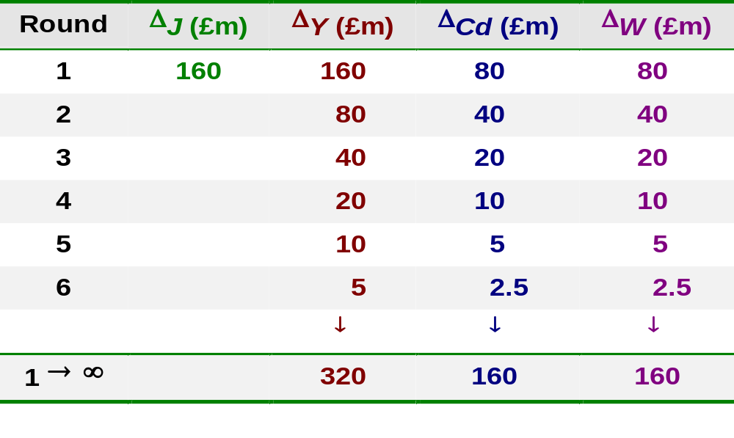
How the multiplier works
For MPC = 0.5 and injections increasing by £160m

Slide 44
(Very long run) Aggregate Supply curve
Suppose aggregate demand increases
Increased investments shift the LRAS to the right
If investment responsive to demand conditions can have flat vLRAS curve
vLRAS would be steeper if extra I cause shortages of materials, machinery or labour (economy is already operating near full-capacity)

Slide 45
Effect of investment on the long-run AS curve
SRAS₁
Price level
a
AD₁
Real national income (GDP)
Notes:
45

Slide 46
Effect of investment on the long-run AS curve
Increased potential output in the long run from higher investment
LRAS₁
LRAS₂
b
When investment responsive to demand, vLRAS curve is flat
vLRAS
Price level
d
a
AD₂
AD₁
Real national income (GDP)
Notes:
46

Slide 47
Breakdown of the Phillips curve
75
Possible Phillips curves?
80
74
76
77
22
79
Inflation rate (%)
81
71
90
73
78
82
89
72
70
91
85
65
69
23
10
11
88
84
66
62
67
68
21
07
08
95
92
87
83
18
17
04
06
98
97
12
61
64
19
05
03
00
13
96
94
86
63
24
93
25
01
14
60
20
16
02
99
15
09
Unemployment rate (%)
Source: Based on data from the Office for National Statistics; forecasts based on data from World Economic Outlook Database (IMF)

Slide 48
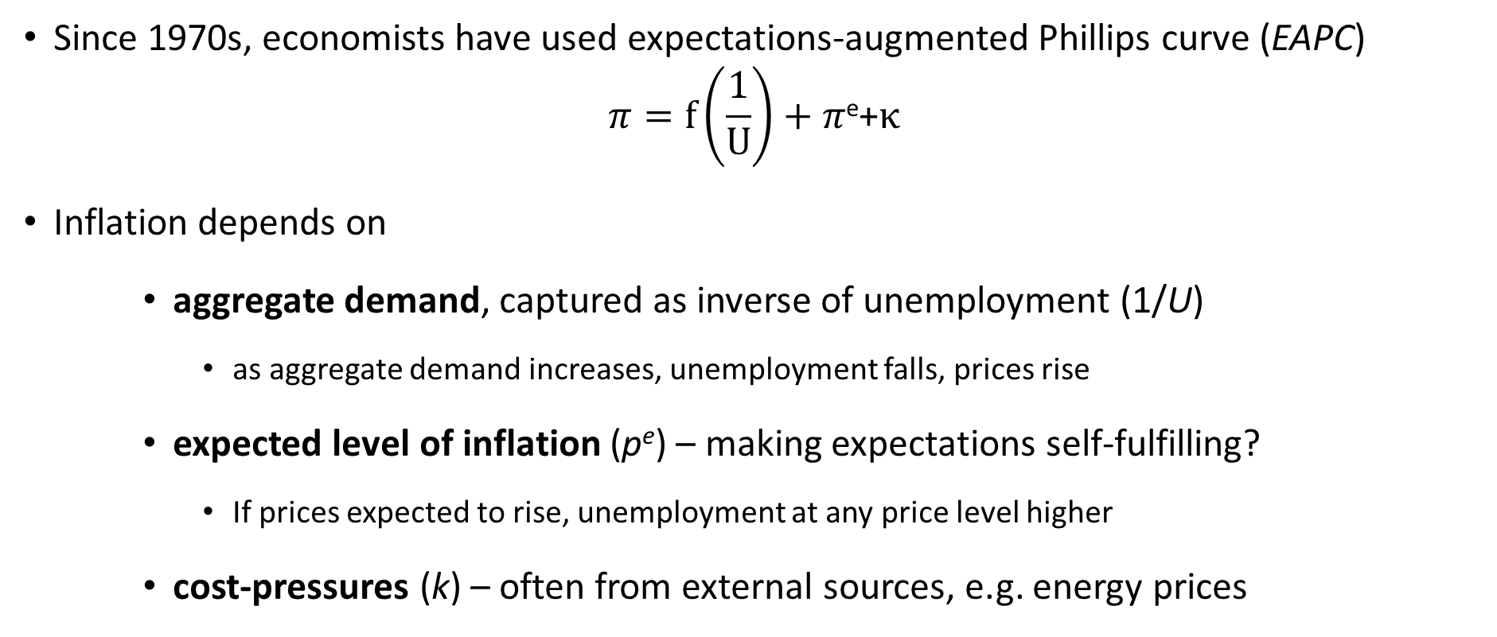
Explaining the changing Phillips’ relation (will not be tested in exam)
Since 1970s, economists have used expectations-augmented Phillips curve (EAPC)
$$π=f\left(\frac{1}{U}\right)+π\text{e}\text{+}κ$$
Inflation depends on
    aggregate demand, captured as inverse of unemployment (1/U)
      as aggregate demand increases, unemployment falls, prices rise
    expected level of inflation (p^{e}) – making expectations self-fulfilling?
      If prices expected to rise, unemployment at any price level higher
    cost-pressures (k) – often from external sources, e.g. energy prices

Slide 49
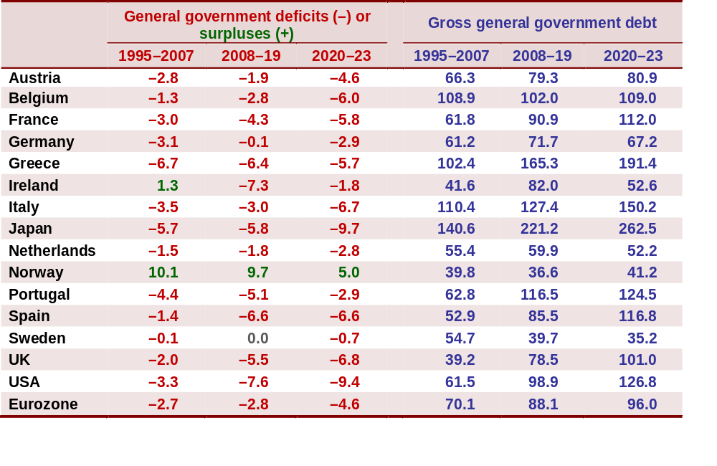
General government deficits/surpluses
and debt as % of GDP
Source: Based on data from AMECO database, Tables 16.3 and 18.1 (European Commission, DGECFIN, 2022)

Slide 50
UK public-sector current and capital expenditures
(financial years beginning)
Note: data are based on financial years; forecasts from 2022/23
Sources: Public Finances Databank, Office for Budget Responsibility

Slide 51
UK public-sector spending and receipts (financial years)
Notes: OBR forecasts from 2022/23. Figures exclude public banks.
Source: Public Finances Databank, Office for Budget Responsibility (November 2022)

